Slide 1
Hypothesis test

Slide 2
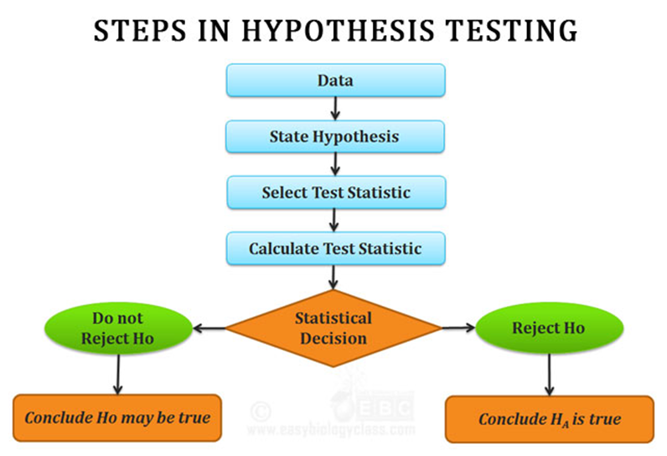
Hypothesis Testing : Hypothesis testing is an act in statistics whereby an analyst tests an assumption regarding a population parameter.

Slide 3
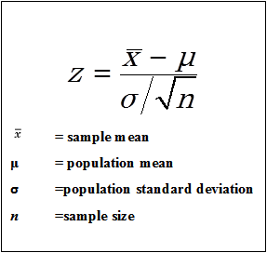
Hypothesis formula

Slide 4
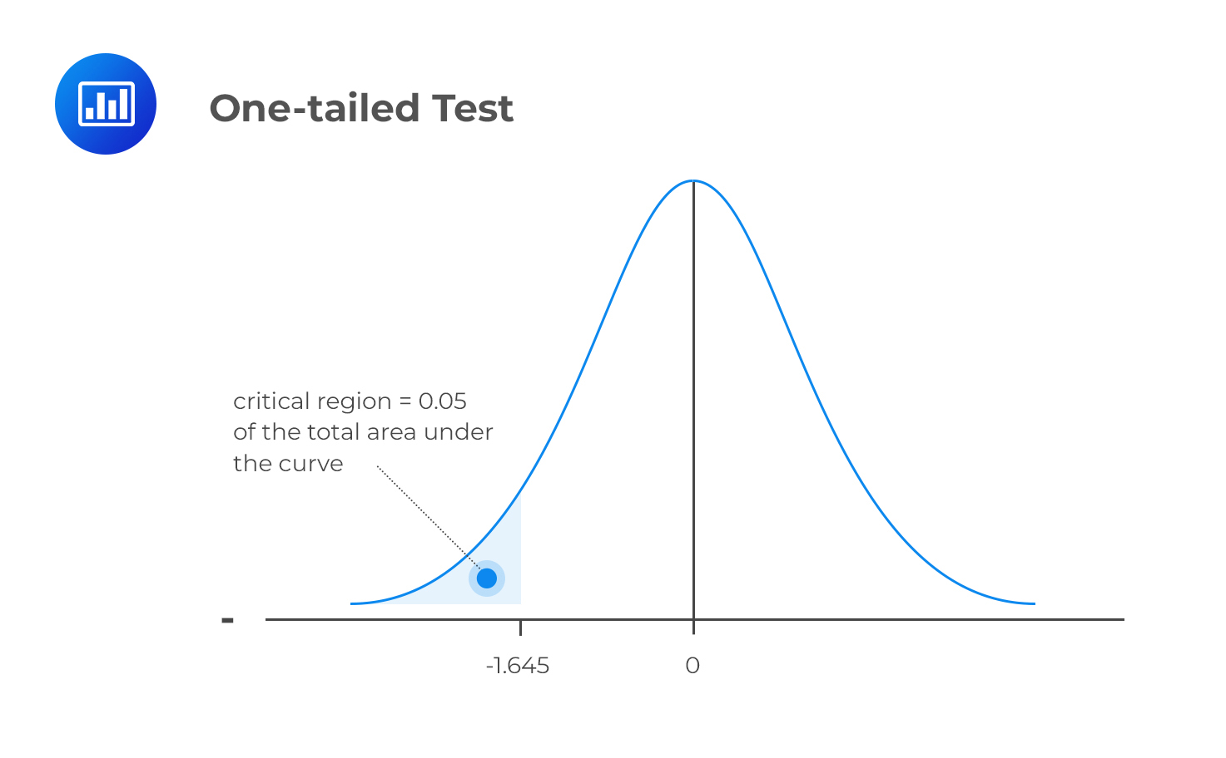
One Tail Test : A one-tailed test results from an alternative hypothesis which specifies a direction. i.e. when the alternative hypothesis states that the parameter is in fact either bigger or smaller than the value specified in the null hypothesis.

Slide 5
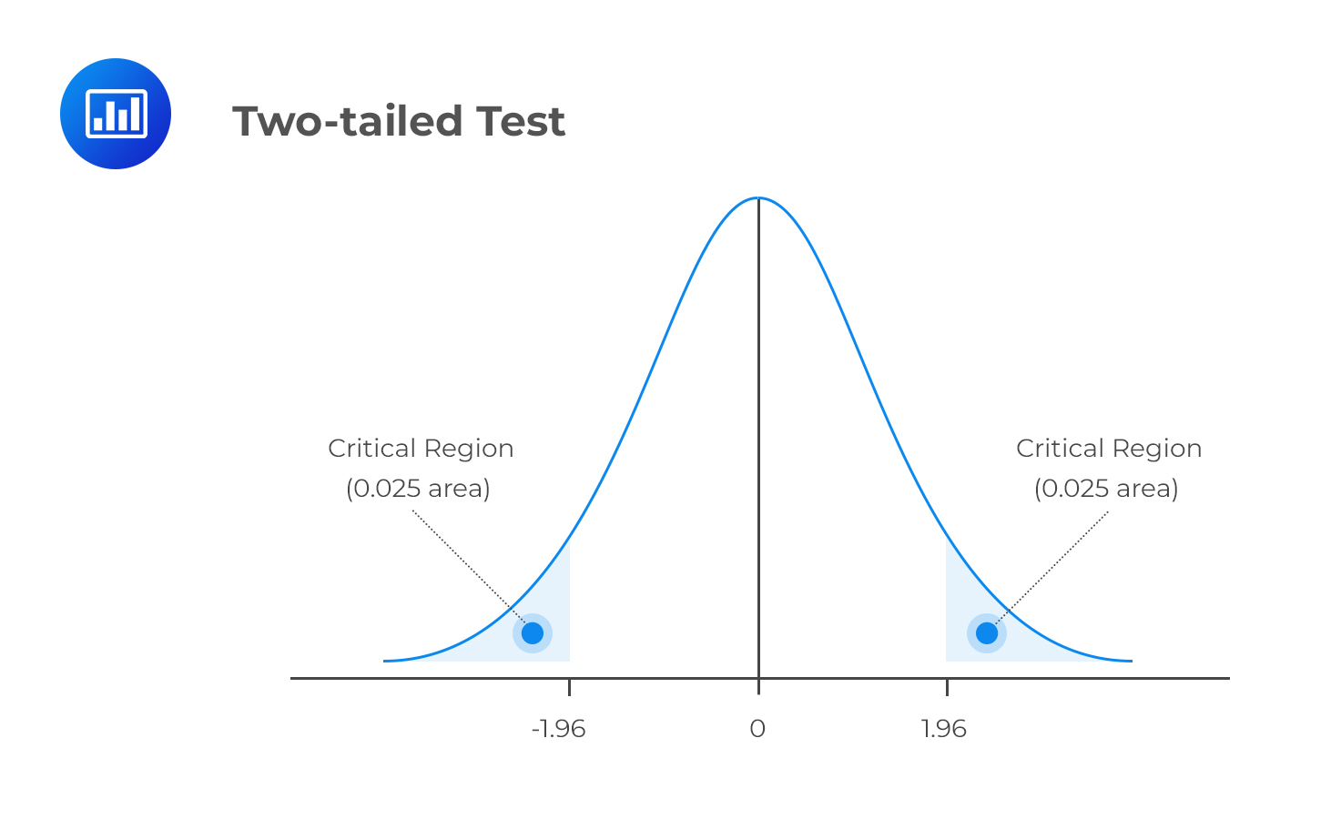
Two Tail Test : A two-tailed test, in statistics, is a method in which the critical area of a distribution is two-sided and tests whether a sample is greater than or less than a certain range of values

